Slide 1

Importing and transforming data

Slide 2
Contents
Importing rectangular text files
Importing other types of data
Transforming data

Slide 3
Importing data with readr

Slide 4

The readr package
Many R packages provide examples of data
However, sooner or later you will need to work with your own data
readr is for rectangular text data
readr supports several file formats with seven read_ functions:
read_csv(): comma-separated (CSV) files
read_tsv(): tab-separated files
read_delim(): general delimited files
read_fwf(): fixed-width files
read_table(): tabular files where columns are separated by white-space
read_log(): web log files
In many cases, supply a path to a file and get a tibble back

Slide 5
Comparison with base r
Why are we learning the readr package?
Base R has a function read.csv() to read CSV files
Some advantages of readr:
It is up to 10x faster
It produces tibbles instead of data.frames
Better parsing (e.g., does not convert strings to factors)
More reproducible on different systems
Progress bar for large files

Slide 6
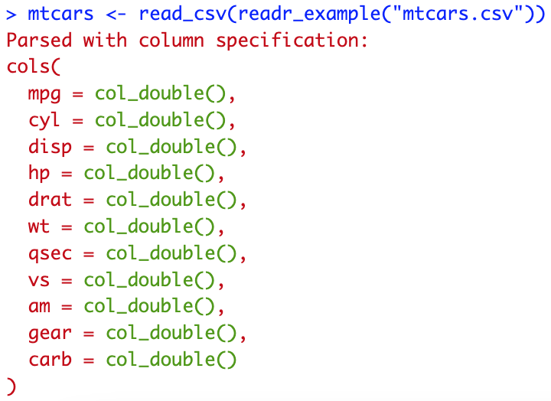
Reading comma-separated files
All read_ functions have a similar syntax, so we will focus on read_csv()
Fuel consumption, 10 aspects of design and performance (?mtcars)

Slide 7
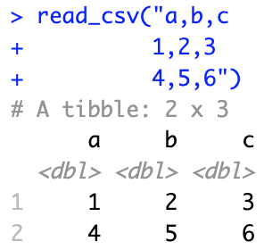
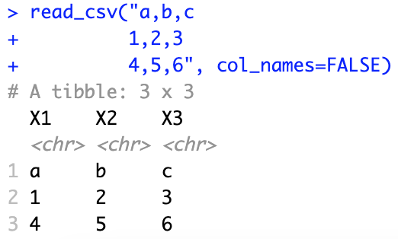
The read_csv function
Also works with inline csv files (useful for experimenting)
First line use as column names, but this can be changed
Other useful tweaks: skip lines (metadata), symbol for missing data (N.A.)
Now you can read most CSV files
Also easily adaptable to read_tsv and read_fwf

Slide 8
Parsing vectors with readr

Slide 9


Parsing a vector
Functions parse_*() take a character vector and return a specialized vector
These are important building blocks for readr
Useful functions:
parse_logical()
parse_integer()
parse_double(), parse_number() for numbers from other countries
parse_character() for character encodings
parse_factor()
parse_datetime(), parse_date(), parse_time()

Slide 10
Some difficulties
Parsing is not always trivial
Numbers are written differently in different parts of the world (“,” vs. “.”)
Numbers are often surrounded by other characters (“$1000”, “10%”)
Numbers often contain “grouping” characters (“1,000,000”)
There are many different ways of writing dates and times
Times can be in different time zones
Encodings: special characters in other languages

Slide 11
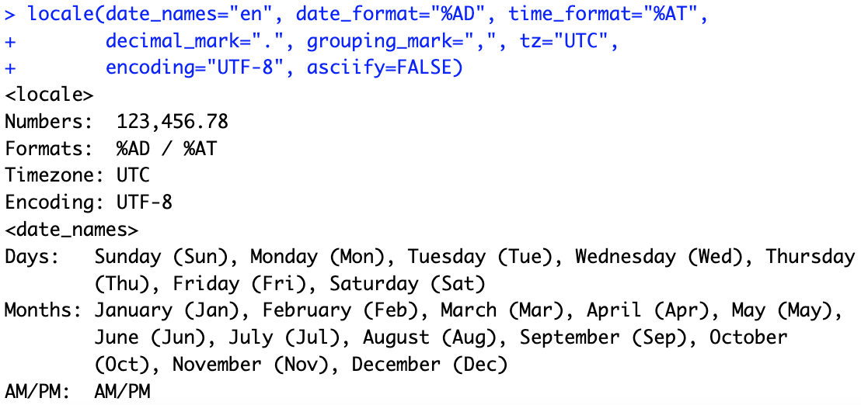
locales
A locale specifies common options varying between languages and places
To create a new locale, you use the locale() function:

Slide 12

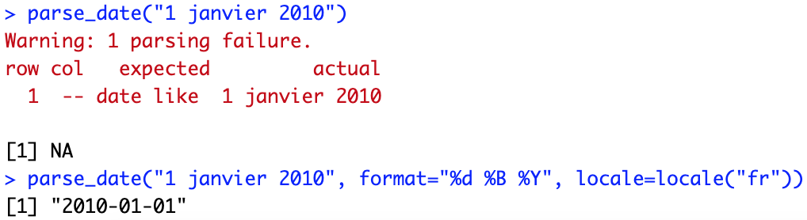
Parsing dates
Example: French format with full name of month:
Learn more by typing ?parse_date

Slide 13

Parsing times
parse_time expects the hour, the colon (:), and the minutes
Optionally: seconds, and am/pm specifier
Parsing dates and times:

Slide 14
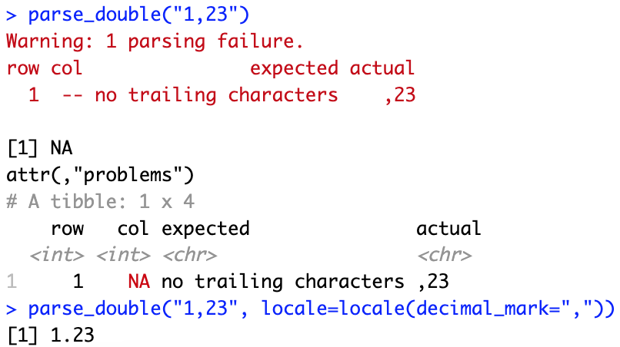
Parsing real numbers
Using a different decimal mark

Slide 15
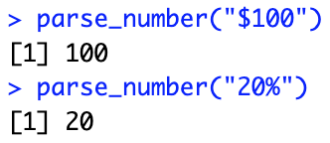
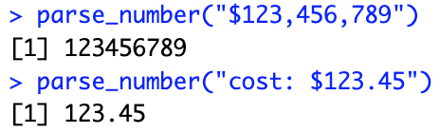
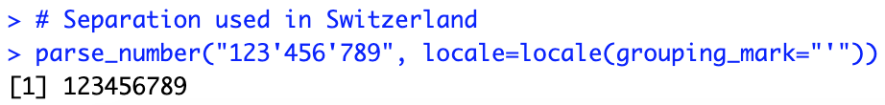
Parsing numbers
parse_number ignores non-numeric characters before and after
Parsing numbers with locales

Slide 16
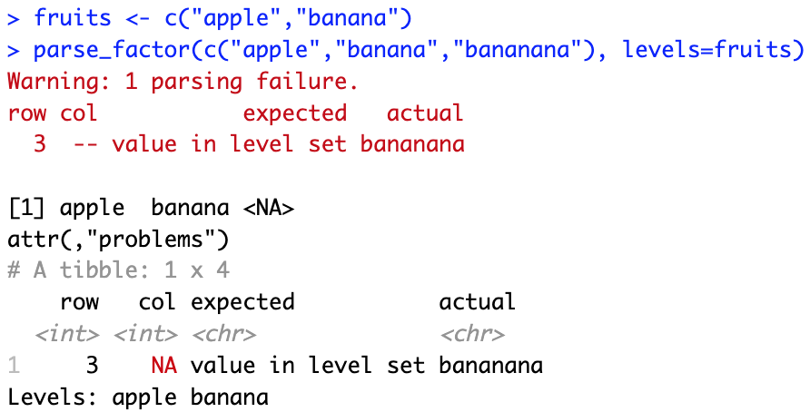
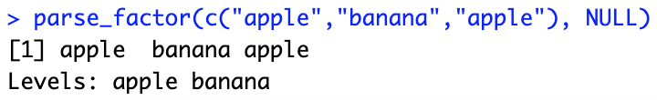
Parsing factors
Factors are categorical variables with a known set of possible values
If the levels are not known in advance:

Slide 17
Parsing files with readr

Slide 18
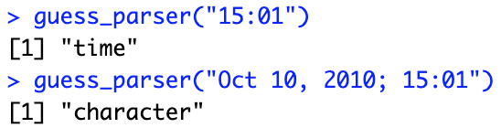
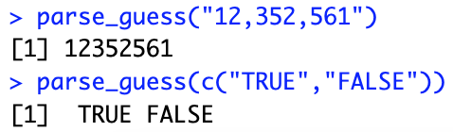
Readr’s strategy
readr uses a heuristic to determine column type using the first 1,000 rows
You can emulate this process with two functions:
guess_parser(): returns readr’s best guess
parse_guess(): uses that guess to parse the column
The heuristic tries a sequence of types and stops when it finds a match
If none of the rules apply, then the column will stay as a vector of strings

Slide 19
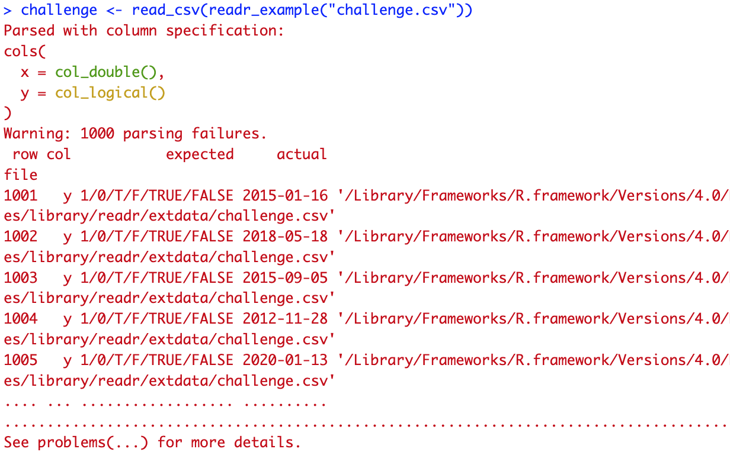
When the default strategy fails
The default strategy does not always work for larger files
The first 1,000 rows might be a special case
The column might contain a lot of missing values

Slide 20
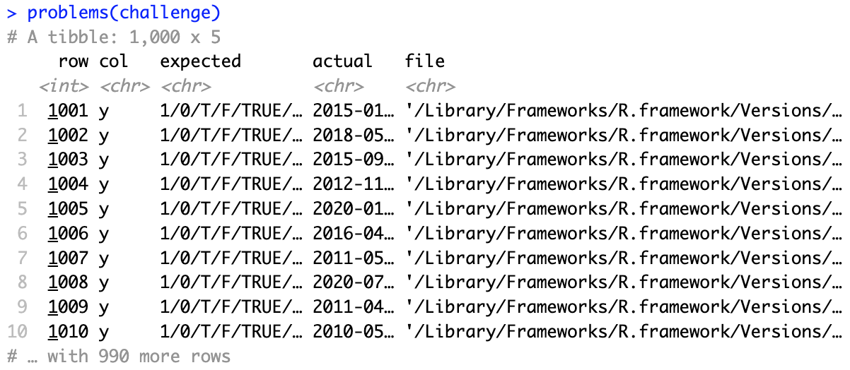
Examining what went wrong
See problems(…) for more details
It seems the first column should be doable
Then work column by column until there are no problems remaining

Slide 21
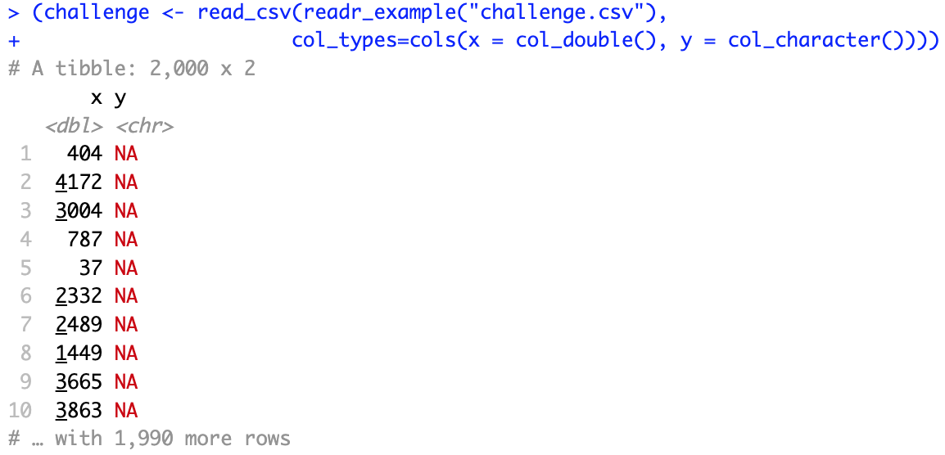
Fixing the column specifications
Automatic column specifications are:
First column should be:

Slide 22
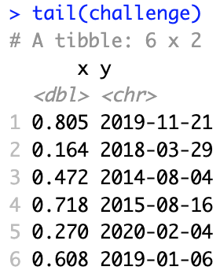
Fixing the column specifications
Are we done?
Check the “y” column
Not yet: dates are stored as strings → to fix this, we use:
Every parse_xyz() function has a corresponding col_xyz() function
col_xyz() tells readr how to load the data

Slide 23
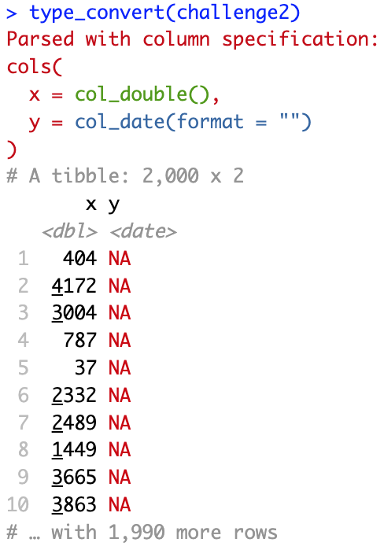
Diagnosing problems
It may be easier to diagnose problems if all columns are read as characters:
Then use type_convert(), which applies the parsing heuristic to the character columns

Slide 24
Transforming data

Slide 25
Data transformation
At this point, we have learned how to:
Import data into R
Visualize it
However, rarely do you get the data in the form you need
For example, you may need to:
Create new variables or summaries
Rename the variables
Reorder the observations
We will now learn how to do this and more

Slide 26
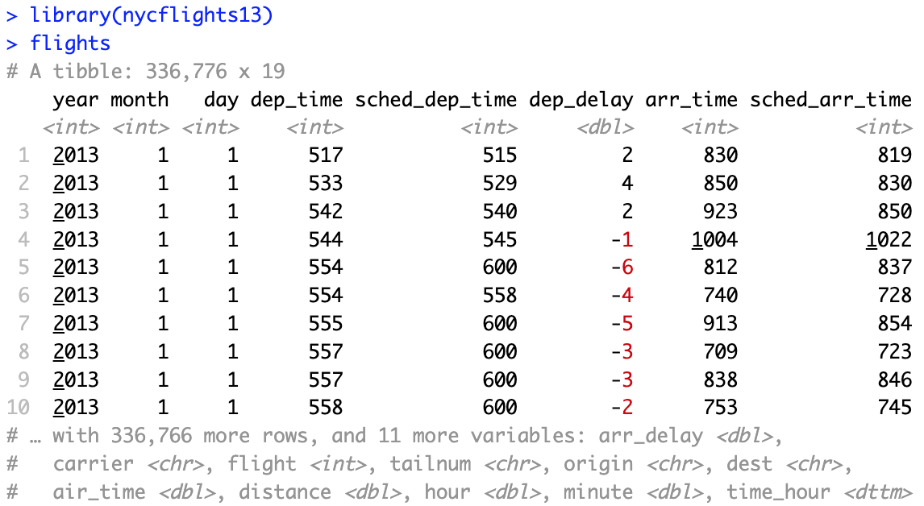
New York city flights data
Dataset on flights departing New York City in 2013

Slide 27
The dplyr package
The dplyr package is part of the core tidyverse
It solves most of your data manipulation challenges:
Pick observations by their values: filter()
Reorder the rows: arrange()
Pick variables by their names: select()
Create new variables with functions of existing variables: mutate()
Collapse many values down to a single summary: summarise()
All verbs work similarly:
The first argument is a tibble or data frame
The subsequent ones describe what to do using the variable names
The result is a new tibble

Slide 28
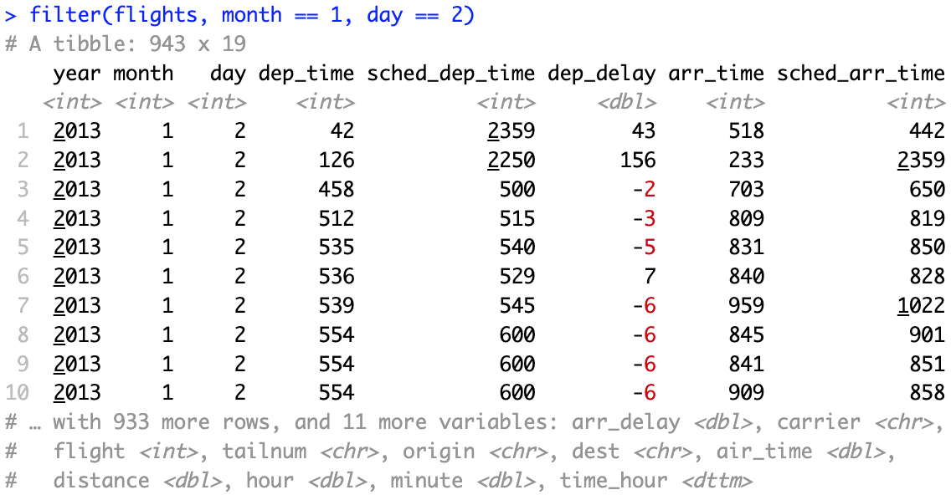
Filter rows with filter()
filter() allows you to subset observations based on their values
The package dplyr executes the filtering and returns a new data frame without modifying the original one

Slide 29
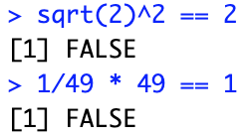
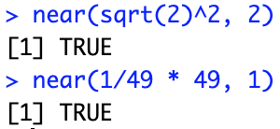
Comparison operators in r
In order to use filter(), you need to use comparison operators
R provides the standard suite: >, >=, <, <=, != (not equal), and == (equal)
The == operator can be tricky with floating point numbers
near() is the safe way of checking if two vectors of floating point numbers are (pairwise) equal

Slide 30
logical operators in r
By default, filter() combines multiple arguments with a logical AND
For example, this finds all flights that departed in November or December:

Slide 31
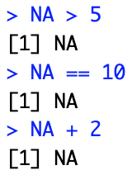
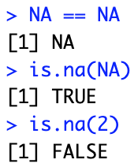
The logic of missing values in r
Missing values are contagious
filter() includes rows where a condition is TRUE (neither FALSE nor NA)

Slide 32
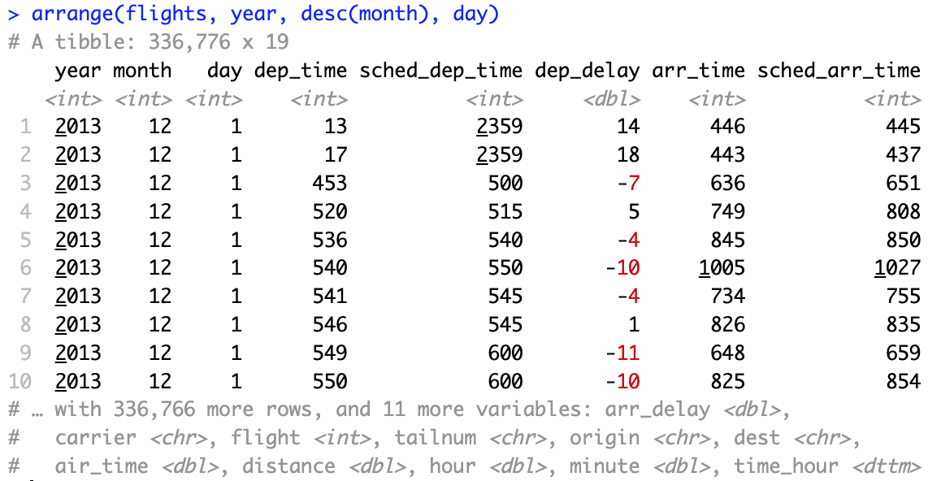
Arrange rows with arrange()
Like filter(), but it only changes the order of rows
It takes a data frame and a set of column names to order by
Additional column names are used to break ties
For descending order, use the function desc() around the column name

Slide 33
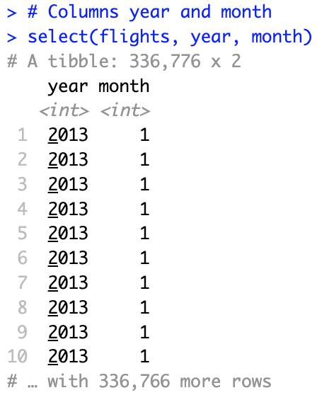
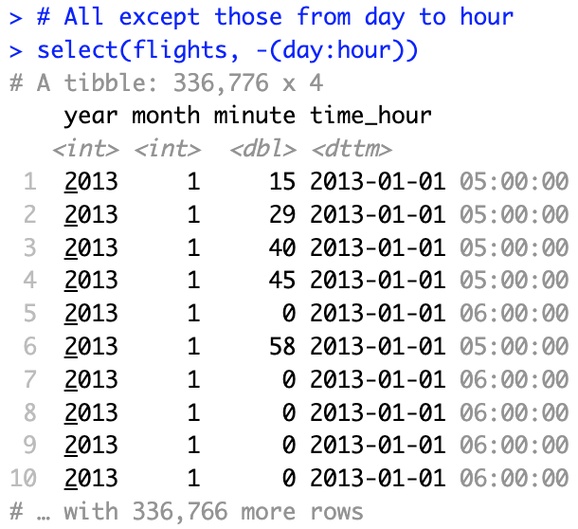
Select columns with select()
select() zooms in on a subset of variables specified by name
This is most useful for large datasets with many variables

Slide 34
Helper functions for select()
There are several helper functions you can use within select():
starts_with(“abc”): matches names that begin with “abc”
ends_with(“xyz”): matches names that end with “xyz”
contains(“ijk”): matches names that contain “ijk”
matches: selects variables that match a regular expression
num_range(“x”, 1:3): matches x1, x2, and x3
To move some columns to the beginning, use the everything() helper:
See ?select for more details

Slide 35
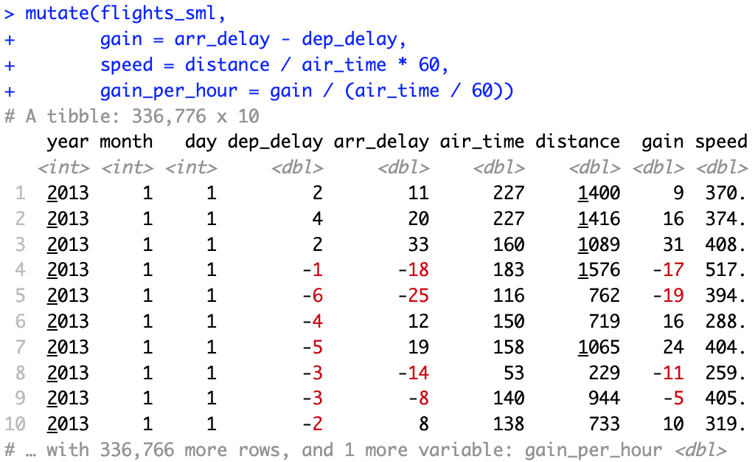
add new variables with mutate()
mutate() adds new columns that are a function of existing ones
To discard old variables, use transmute() instead of mutate()

Slide 36
Helper functions for mutate()
Many functions can be used together with mutate():
Arithmetic operators (+, -, *, /)
Modular arithmetic: integer division (%), remainder (%%)
Logarithms (log, log10) and exponentials (exp)
Offsets (lead, lag)
Cumulative and rolling aggregates (cumsum, cumprod, cumin, cummax)
Logical comparisons (<, <=, >, >=, ==, !=)
Ranking (min_rank, percent_rank)
For details, type ?function_name
Basically, any vectorized function can be used here

Slide 37
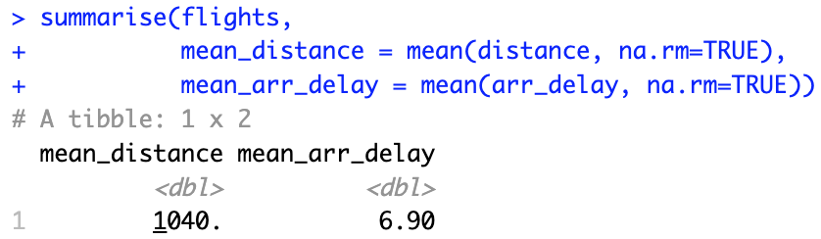
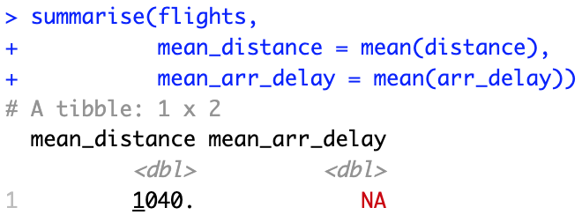
creating summaries with summarise()
The summarise function collapses a data frame to a single row
The argument “na.rm = TRUE” in the mean() function is important

Slide 38
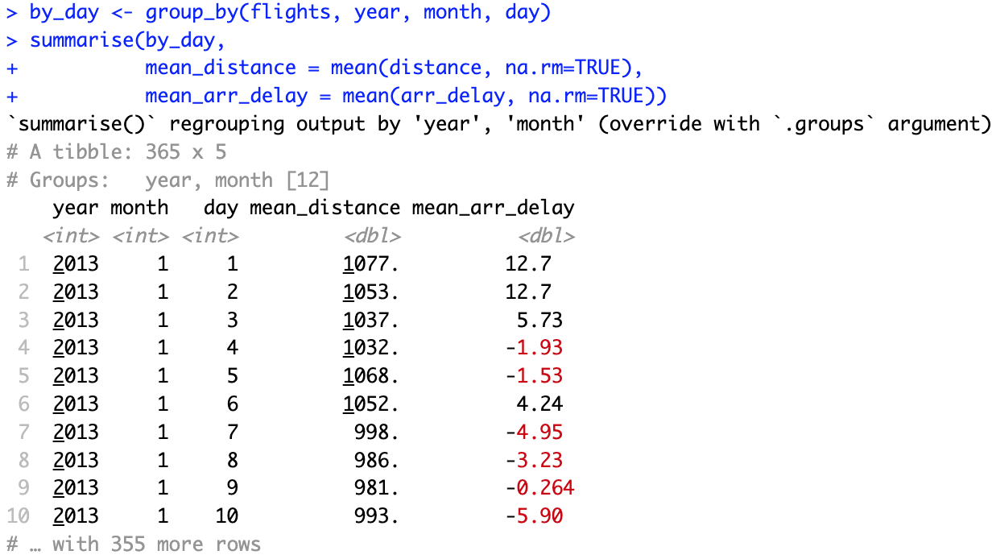
grouped summaries with summarise()
summarise() is more useful when used with group_by()

Slide 39
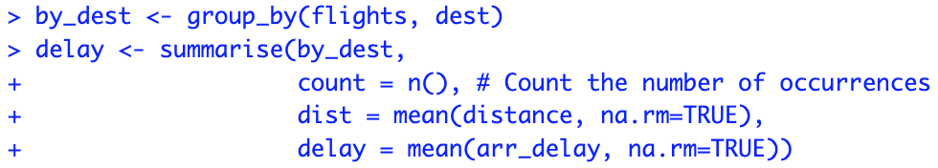
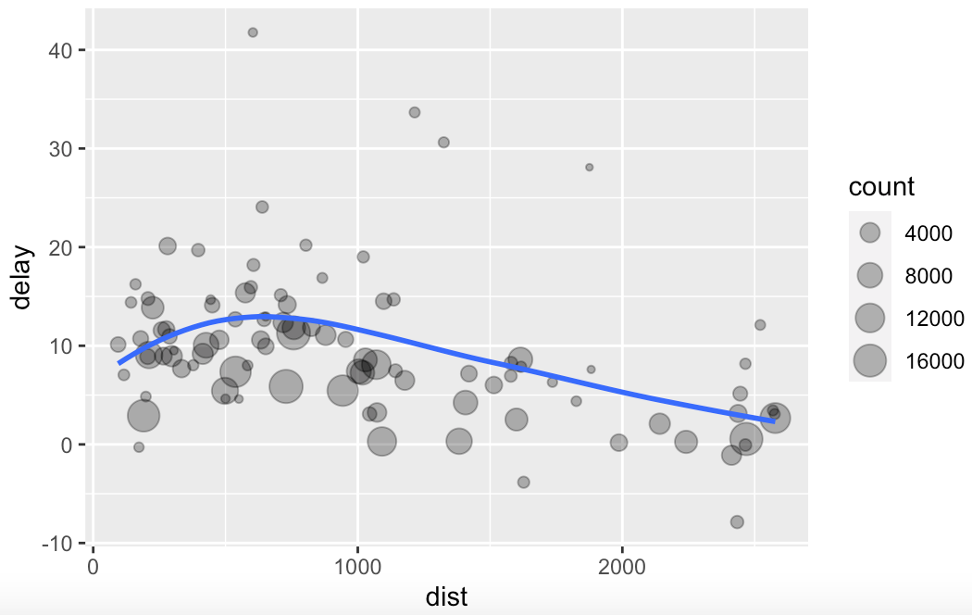
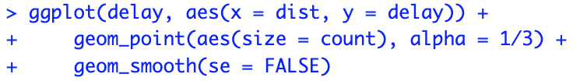
A Data analysis example
Task: determine the relationship between distance and average delay for each location
It looks like delays increase with distance up to ~750 and then decrease

Slide 40
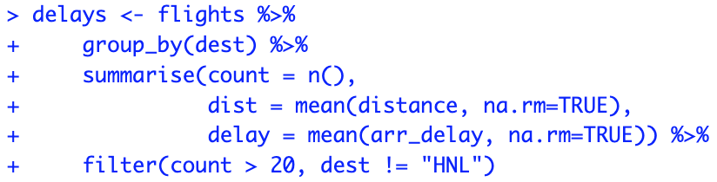
combining multiple operations with the pipe
Our analysis had three steps:
Group flights by destination
Summarise to compute distance, average delay, and number of flights
Filter to remove noisy points and Honolulu airport
Every step creates a new dataset, which we do not need
Solution: the pipe operator “%>%” (general for tidyverse)
Focus on the transformations, not what’s being transformed
x %>% f(y) → f(x, y)
x %>% f(y) %>% g(z) → g(f(x, y), z)

Slide 41
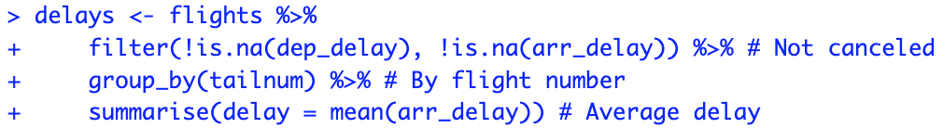
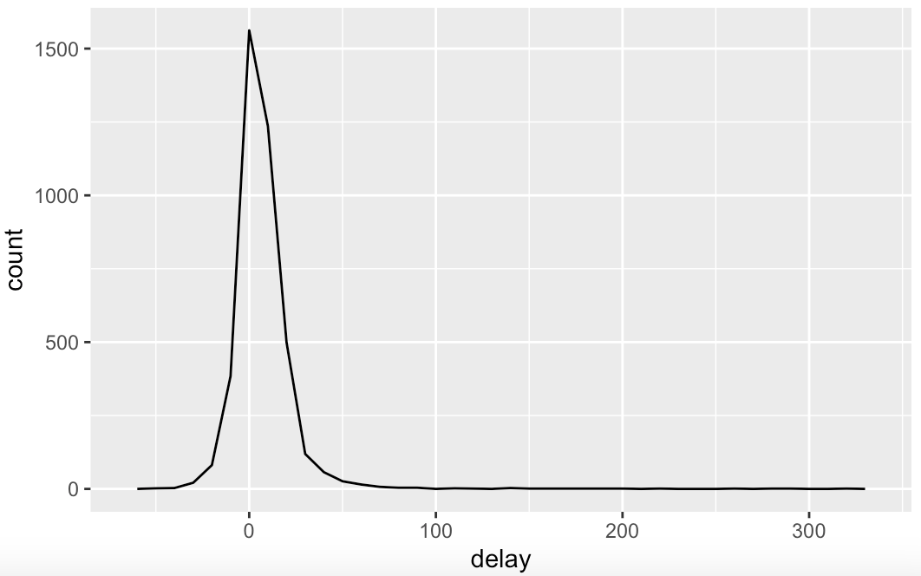
counting values
Whenever you aggregate, it’s useful to include either a count, n(), or a count of non-missing values, sum(!is.na(x))

Slide 42
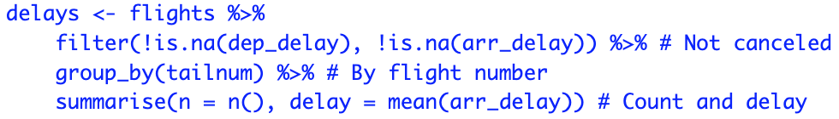
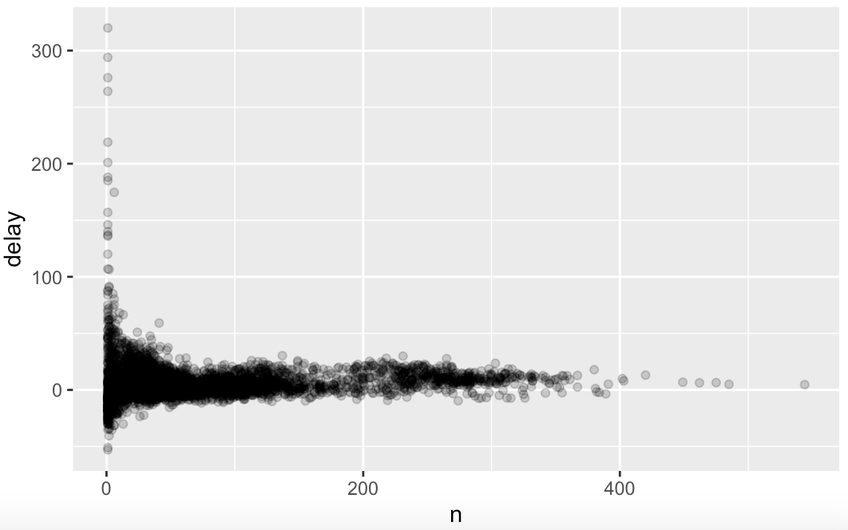
counting values
Gain more insight with scatterplot of number of flights vs. average delay

Slide 43
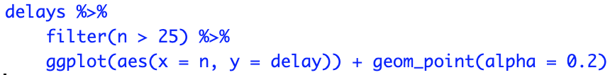
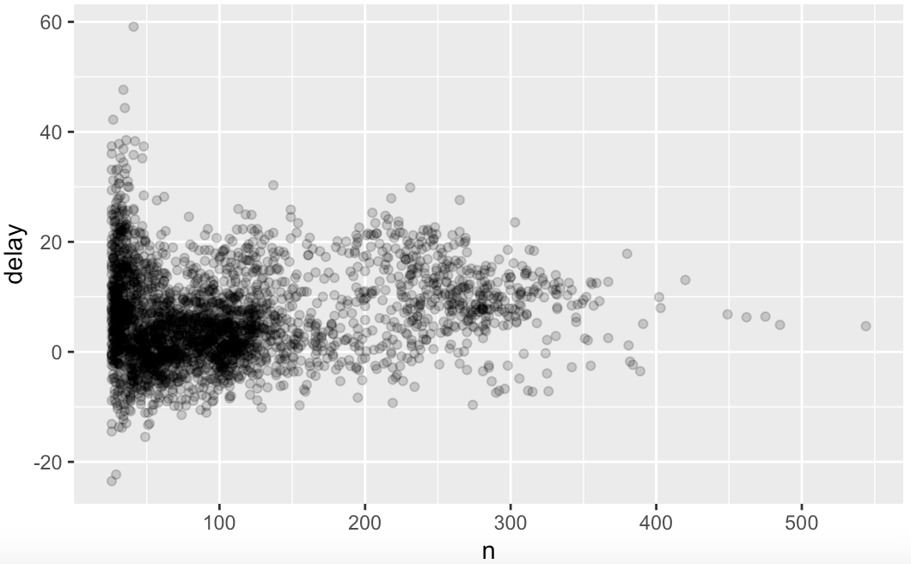
counting values
We can filter out the groups with the smallest numbers of observations
Note that we can also pipe data into ggplot2

Slide 44
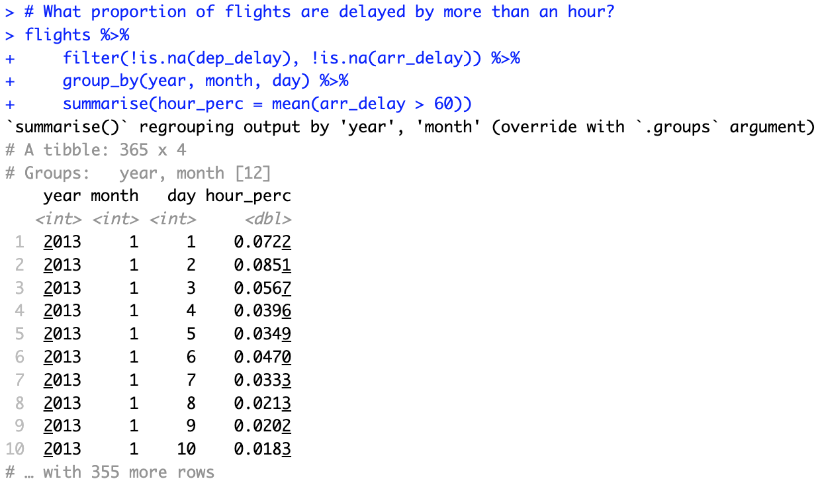
useful summary functions
Measures of location: mean(), median(), or spread: sd()
Measures of rank: min(), quantile(), max()
Measures of position: first(), nth(), last()
Counts: n(), sum(!is.na(x)), n_distinct()
Counts of logical values: sum(x > 10)

Slide 45
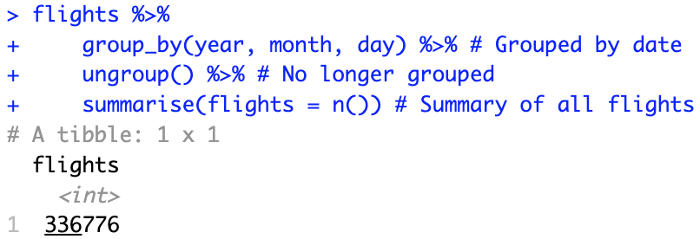
ungrouping
If you need to undo the grouping, use ungroup()
This makes sense if you do some operation on groups before ungrouping

Slide 46
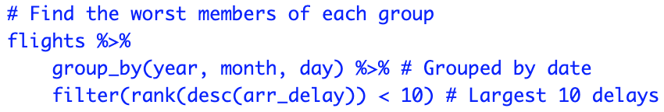
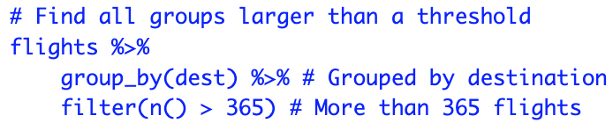
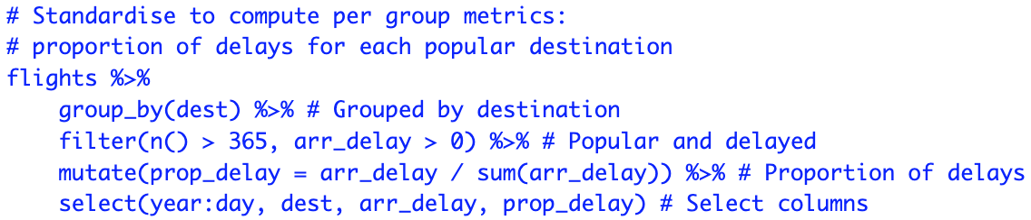
other uses of grouping
Grouping can also do convenient operations with mutate() and filter()
Functions that work most naturally in grouped mutates and filters are called window functions

